Slide 1
Neuseeland
Von Andrea Beispiel

Slide 2
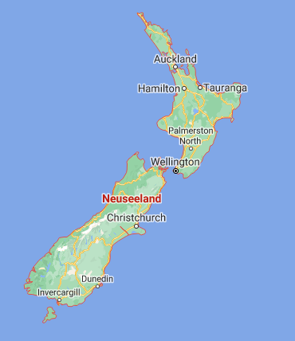
Rotorua

Slide 3
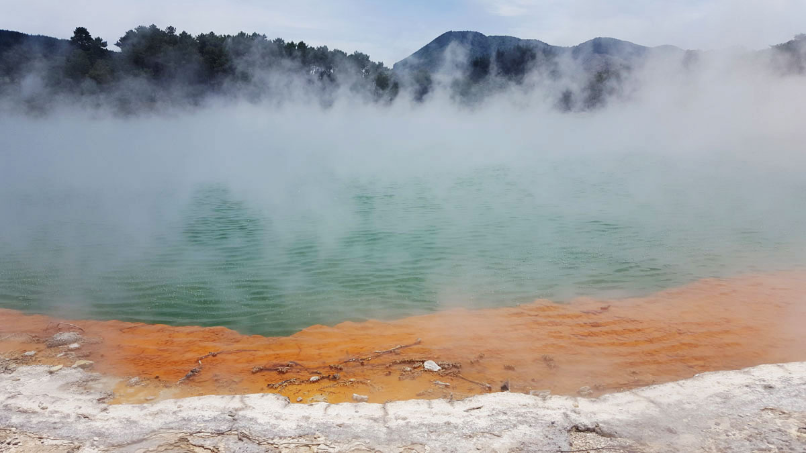
Rotorua_-_Wai-O-Tapu_-_Champagne_Pool_2_-_S0402

Slide 4
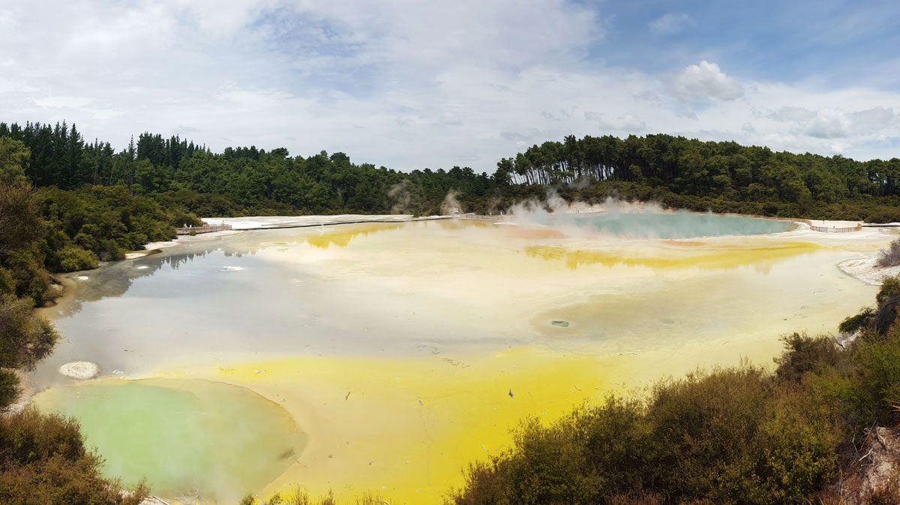
Rotorua_-_Wai-O-Tapu_-_Champagne_Pool_1_-_S0402

Slide 5
Tongariro

Slide 6
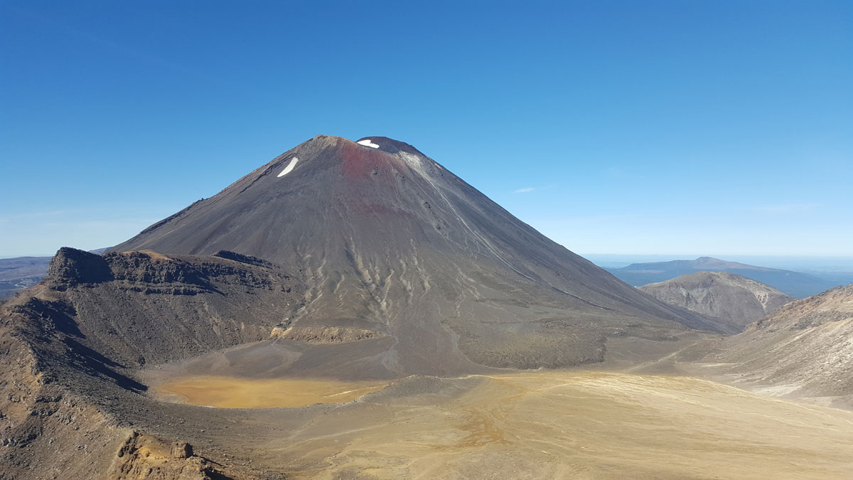
Tongariro_-_Mount_Ngauruhoe_-_S0402

Slide 7
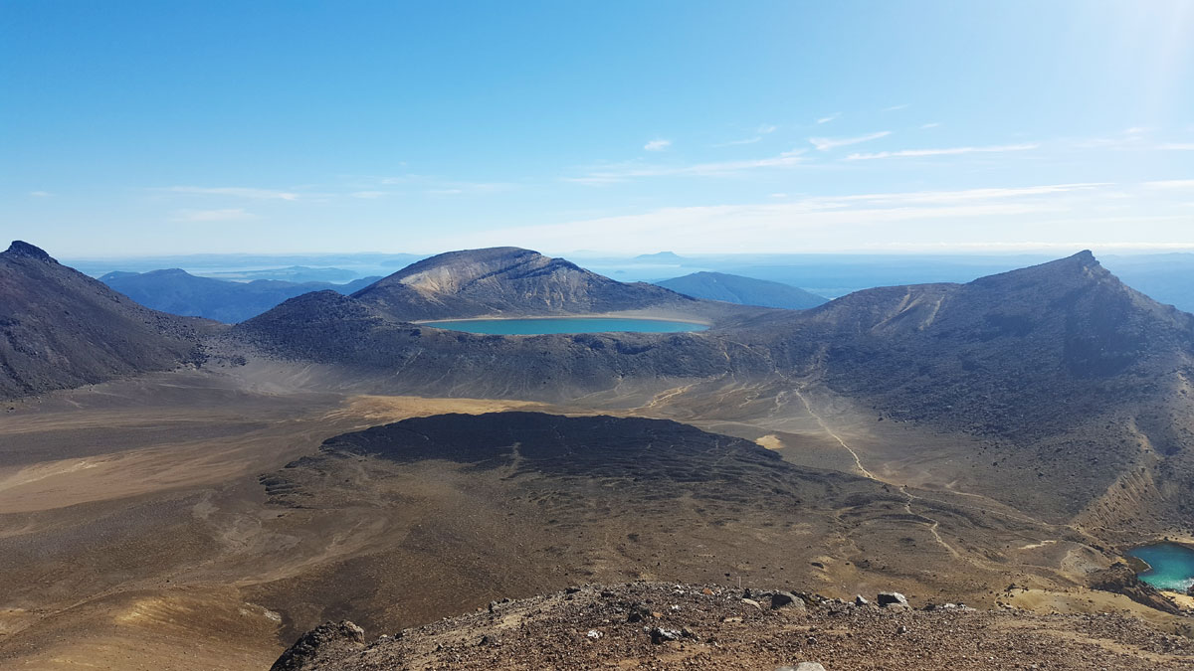
Tongariro_-_Blick_vom_Roten_Krater_-_S0402

Slide 8
Coromandel

Slide 9
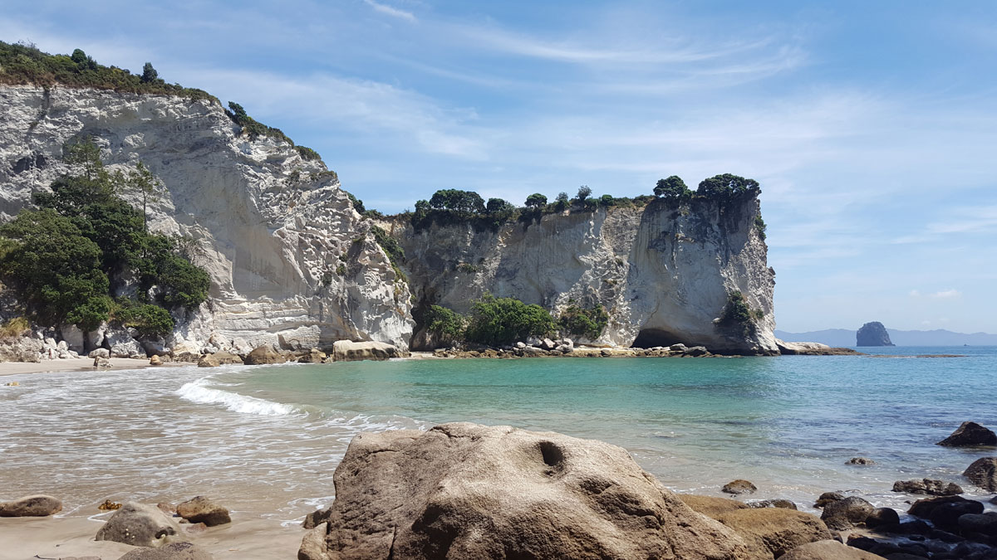
Coromandel_-_Hahei_-_Stingray_Beach_-_S0402

Slide 10
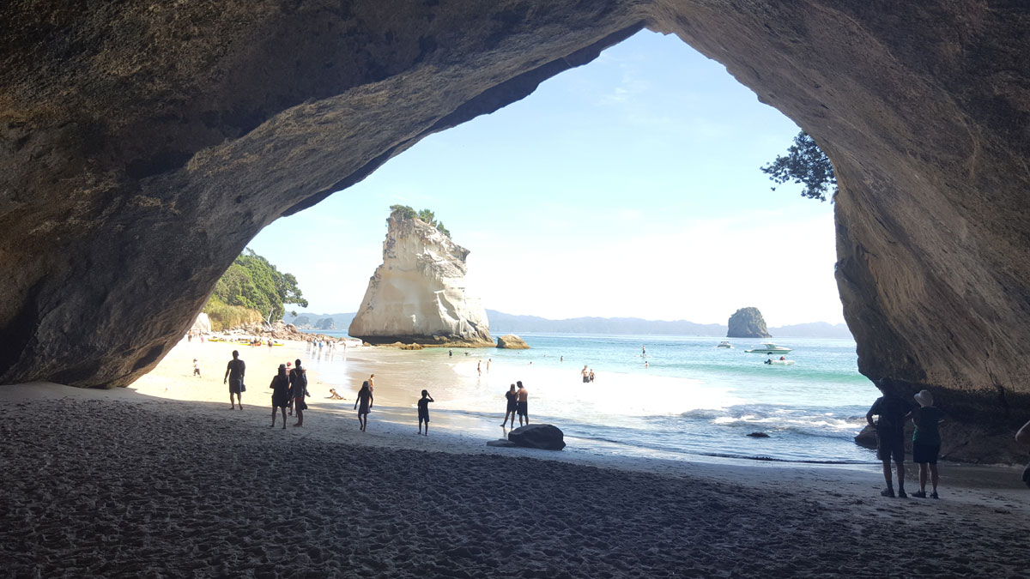
Coromandel_-_Hahei_-_Cathedral_Cove_+_Te_Hoho_Rock_-_S0402

Slide 11
Marlborough Sounds

Slide 12
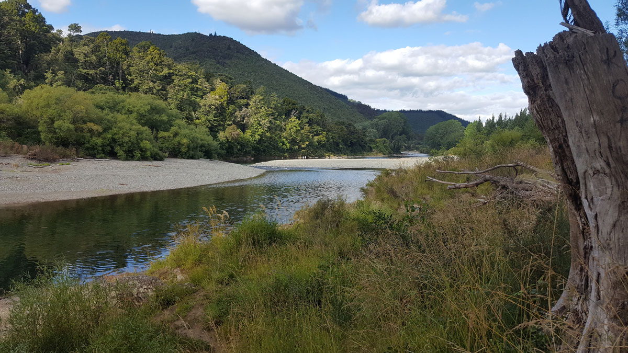
Marlborough_Sounds_-_Rai_Valley_-_S0402

Slide 13
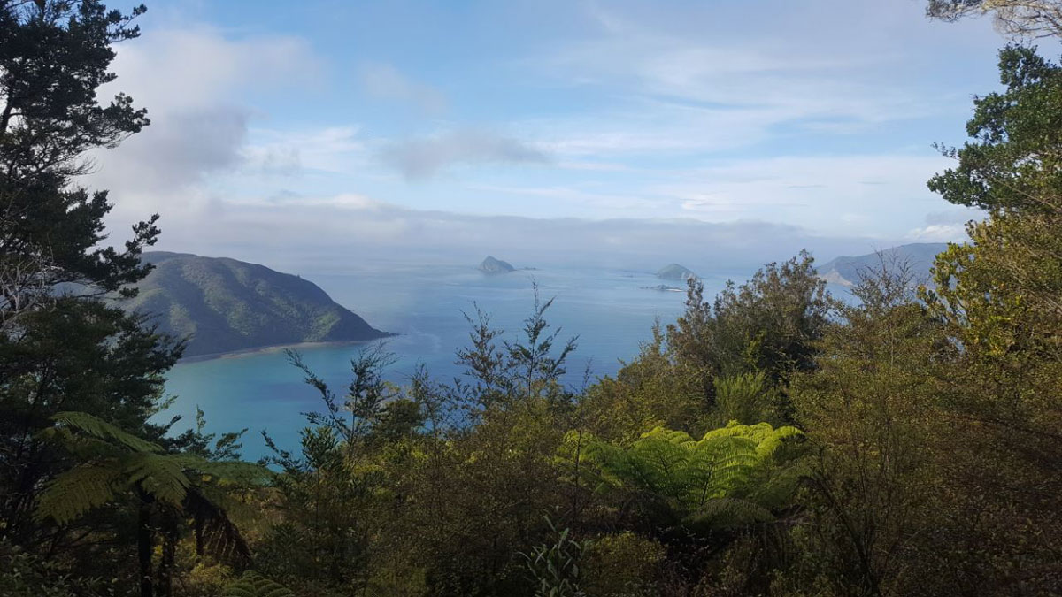
Marlborough_Sounds_-_Okiwi_Bay_-_S0402

Slide 14
Nationalpark Abel Tasman

Slide 15
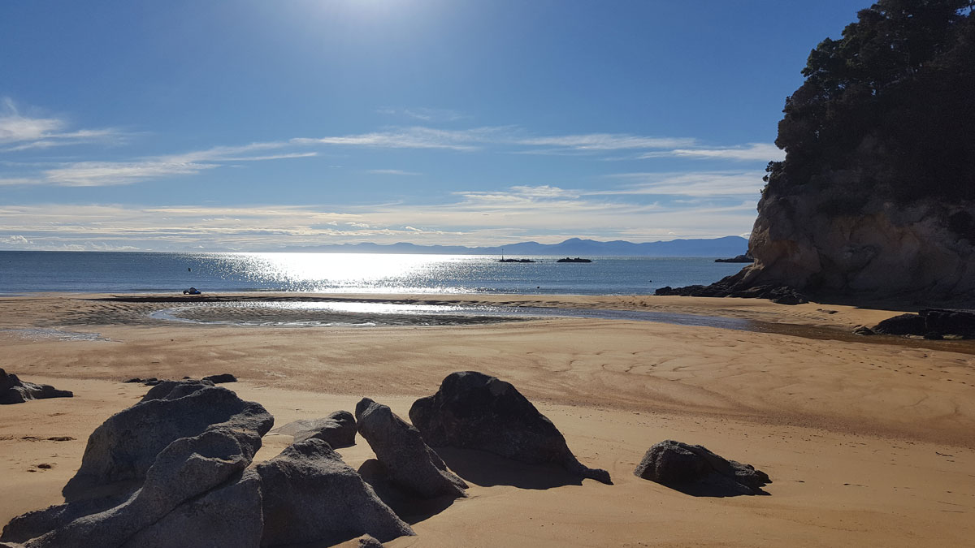
Abel_Tasman_Nationalpark_-_Kaiteriteri_-_S0402

Slide 16
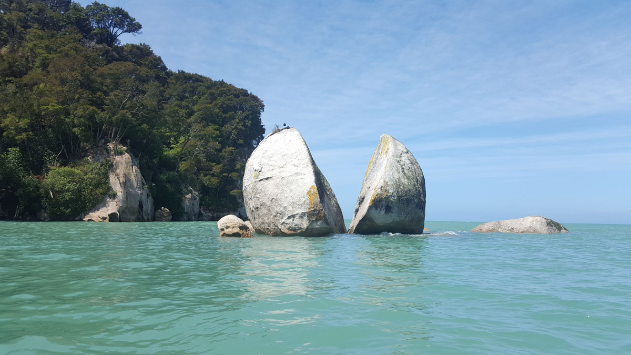
Abel_Tasman_Nationalpark_-_Split_Apple_Rock_-_S0402

Slide 17
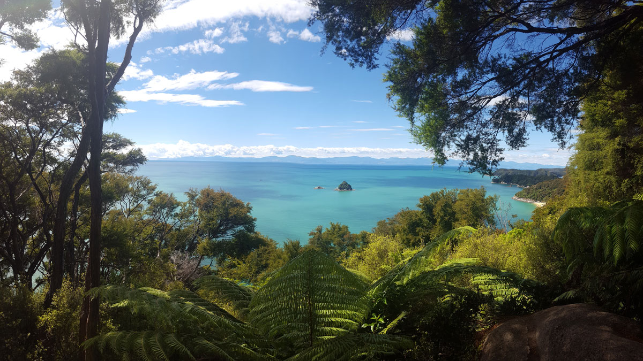
Abel_Tasman_Nationalpark_-_Pinnacle_Island_-_S0402

Slide 18
Farewell Spit

Slide 19
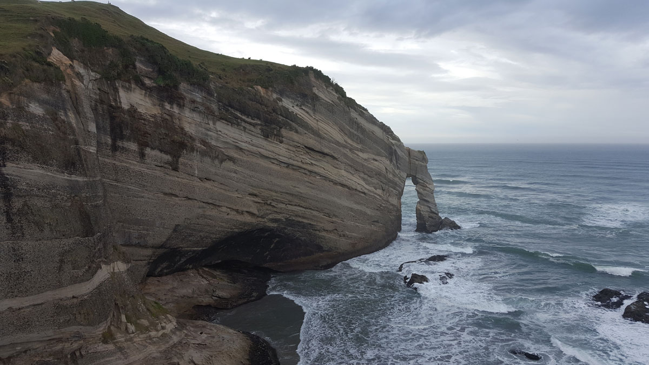
Farewell_Spit_-_Cape_Farewell_-_S0402

Slide 20
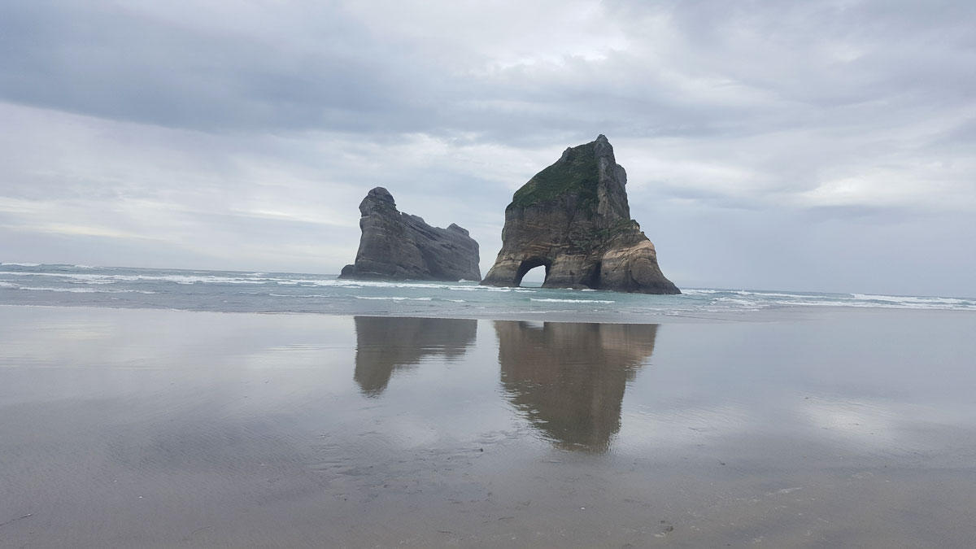
Farewell_Spit_-_Wharariki_Beach_1_-_S0402

Slide 21
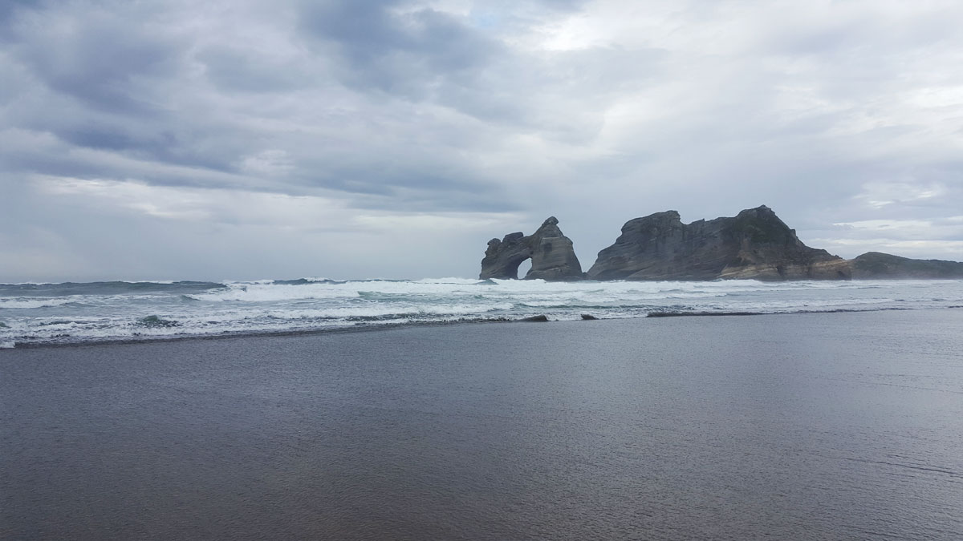
Farewell_Spit_-_Wharariki_Beach_2_-_S0402

